Slide 1

Healthcare Analytics For Doctor Visit TIRTC
Manikanta Subbarao B
STU6424333ea35b91680094014

Slide 2

PROBLEM STATEMENT
Healthcare Analytics For Doctor Visit
Healthcare systems often struggle with understanding the determinants of patient doctor visits, leading to inefficient resource allocation and unaddressed chronic or acute health needs.
Identifying why certain demographic and socioeconomic groups utilize medical consultations more frequently, and how factors like illness, insurance coverage, and income drive healthcare demand.
To analyze patient attributes to uncover utilization patterns and provide actionable insights for optimizing healthcare delivery.

Slide 3
Project Description
This project conducts an in-depth exploratory data analysis (EDA) on a healthcare dataset comprising 5,190 patient records.
Key Variables Analyzed:
  Target variable: Number of doctor visits.
  Demographics: age, gender, and scaled income.
  Health status: Number of illnesses, reduced activity days, general health status score, and chronic conditions (nchronic, lchronic).
  Insurance status: private health insurance, freepoor (free government insurance due to low income), and freerepat (free government insurance for repatriation/veterans).
Methods Used: Data cleaning, univariate distribution plotting (histograms, count plots), and bivariate correlation analysis using Python (Pandas, Seaborn, Matplotlib).

Slide 4

WHO ARE THE END USERS?
1. Healthcare Providers & Clinicians (Doctors & Nurses)
Role: Primary care providers and clinic managers.
2. Hospital Administrators & Healthcare Planners
Role: Facility directors and operational decision-makers.
3. Health Insurance Companies & Payers
Role: Actuaries, risk analysts, and product managers.
4. Public Health Policy Makers & Government Agencies
Role: Public health researchers and policy planners.

Slide 5

Technology Used
Programming Language: Python
Data Manipulation & Analysis: Pandas, NumPy
Data Visualization: Matplotlib, Seaborn
Development Environment: Jupyter Notebook / Python Interpreter

Slide 6
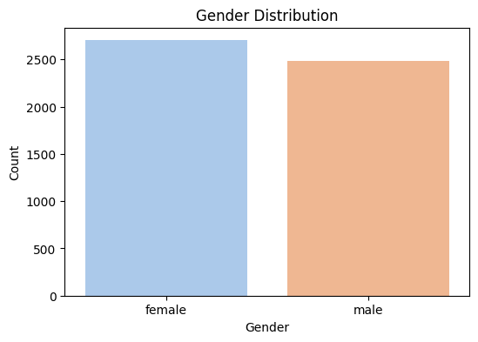
RESULTS
The dataset contains 2,702 female and 2,488 male patient records, allowing for balanced gender-based utilization comparisons.

Slide 7
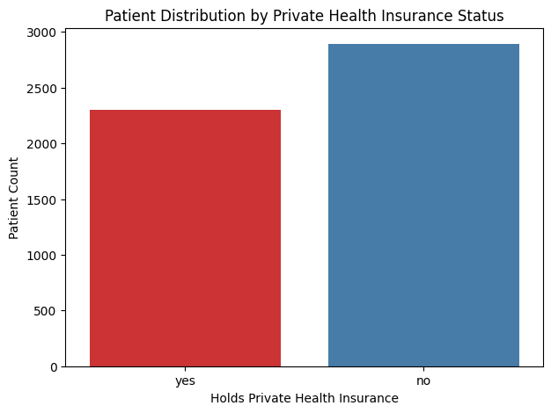
RESULTS
Out of the total patients, 2,298 hold private health insurance (yes), while 2,892 do not (no), highlighting distinct socio-economic splits in healthcare access.
https://github.com/Vitry543/Healthcare-Analytics-For-Doctor-Visit-.git

Slide 8

Thank you
.
.

